Slide 1

Introduction to AI(AI101B) Analyzing website traffic data session 2024-25 Even Semester
Team Leader: Deepak Sharma and University Roll no. : 202410116100055
Member Name: Chetanya Bedi and University Roll no. : 202410116100053
Member Name: Devansh Kumar and University Roll no. : 202410116100059
Member Name: Dhruv Bathla and University Roll no. : 202410116100062
Project Supervisor : Mr. Apoorv Jain

Slide 2
Content
Introduction
Methodology
Code
Screenshots Output

Slide 3
Introduction
In the digital era, understanding website traffic is crucial for optimizing user experience and improving business strategies. This project, Analyzing Website Traffic Data, focuses on collecting, processing, and interpreting visitor data to uncover patterns, trends, and user behavior. By leveraging analytical tools and techniques, we aim to identify key performance metrics such as page views, bounce rates, session durations, and traffic sources.
The insights gained will help enhance website efficiency, boost engagement, and drive data-driven decision-making. This study provides a structured approach to web analytics, offering valuable recommendations for businesses to refine their online presence and achieve strategic goals.

Slide 4
This project, Analyzing Website Traffic Data, aims to explore how users interact with websites by examining key metrics such as traffic sources, session duration, bounce rates, and user demographics. By leveraging data analysis techniques, we can uncover patterns, detect trends, and identify potential areas for improvement.
The insights gained will help optimize website performance, enhance marketing strategies, and improve user engagement. This project will provide a data-driven approach to decision-making, enabling businesses to refine their digital presence and maximize their online impact.

Slide 5
Methodology
Data Collection :
Gather website traffic data using tools like Google Analytics, server logs, or third-party tracking software.
Record key metrics such as page views, sessions, traffic sources, and bounce rates.
Data Preprocessing :
Clean and filter data to remove inconsistencies, duplicates, and missing values.
Structure data for accurate analysis.

Slide 6
Methodology
Data Analysis :
Apply statistical and analytical techniques to identify trends and patterns.
Use visualization tools (graphs, charts) to interpret findings
Interpretation & Reporting :
Summarize findings into reports with actionable insights.
Provide recommendations to optimize website performance and user experience.

Slide 7
Code Typed
# IMPORTING BASIC LIBRARIES
import pandas as pd
import numpy as np
import matplotlib.pyplot as plt
import seaborn as sns
# LOADING THE DATASET USING PANDAS PD.READ_CSV() FUNCTION
traffic = pd.read_csv("website_trafficdata.csv")
print("Dataset Loaded Successfully")
# DISPLAYING TOP 5 ENTRIES OF THE DATASET
traffic.head()
# DISPLAYING LAST 5 ENTRIES OF THE DATASET
traffic.tail()
# DESCRIPTIVE ANALYSIS
traffic.describe()

Slide 8
Code Typed
# EXAMINING DATASET'S SHAPE
traffic.shape
# GOING THROUGH DATA'S BASIC INFORMATION
traffic.info()
# FINDING NULL VALUES
traffic.isnull().sum()
# EXAMINING UNIQUE VALUES OF DATASET
traffic.nunique()
# FINDING VALUE COUNT OF '1.0' IN CONVERSION RATE COLUMN
con_count = traffic['Conversion Rate'].value_counts().get(1.0, 0)
# PRINTING VALUE COUNT
con_count

Slide 9
Code Typed
np.int64(1773)
# EXAMINING OUTLIERS
traffic_num = traffic.drop('Traffic Source', axis=1)
# CREATING A BOX PLOT
fig, axs = plt.subplots(6,1,dpi=95, figsize=(7,17))
i = 0
for col in traffic_num.columns:
axs[i].boxplot(traffic_num[col], vert=False)
axs[i].set_ylabel(col)
i += 1
plt.show()
# DROPPING OUTLIERS
columns = ['Page Views', 'Session Duration', 'Bounce Rate', 'Time on Page', 'Previous Visits', 'Conversion Rate']

Slide 10
Code Typed
or col in columns:
q1, q3 = np.percentile(traffic[col], [25, 75])
iqr = q3 - q1
lower_bound = q1 - (1.5 * iqr)
upper_bound = q3 + (1.5 * iqr)
traffic = traffic[(traffic[col] >= lower_bound) & (traffic[col] <= upper_bound)]
print("Dropped outliers successfully!")
# EXAMINING CORRELATIONS
traffic_clean_num = traffic.drop('Traffic Source', axis=1)
corr = traffic_clean_num.drop('Conversion Rate', axis=1).corr()
plt.figure(dpi=100)
sns.heatmap(corr, annot=True, fmt= '.2f')
plt.show()

Slide 11
Code Typed
# DATA VISUALIZATION & TRAFFIC SOURCE DISTRIBUTION
traffic_counts = traffic['Traffic Source'].value_counts()
# CREATING A BAR GRAPH
traffic_counts.plot(kind='bar', figsize=(10, 6))
plt.title('Traffic Source Distribution')
plt.xlabel('Traffic Source')
plt.ylabel('Count')
plt.show()
# RELATIONSHIP BETWEEN SESSION DURATION AND BOUNCE RATE
plt.figure(figsize=(10, 6))
sns.scatterplot(x='Session Duration', y='Bounce Rate', data=traffic_clean_num)
plt.title('Session Duration vs Bounce Rate')
plt.xlabel('Session Duration (in minutes)')
plt.ylabel('Bounce Rate (in percentage)')
plt.show()

Slide 12
Code Typed
# RELATIONSHIP BETWEEN PAGE VIEWS AND SESSION DURATION
page_views = traffic_clean_num['Page Views']
session_duration = traffic_clean_num['Session Duration']
plt.figure(figsize=(8, 4))
plt.bar(page_views, session_duration)
plt.title('Page Views vs Session Duration')
plt.xlabel('Page Views')
plt.ylabel('Session Duration (in minutes)')
plt.show()
# RELATIONSHIP BETWEEN TIME ON PAGE AND CONVERSION RATE
plt.figure(figsize=(8,4))
sns.scatterplot(x='Time on Page', y='Conversion Rate', data=traffic_clean_num)
plt.title('Time On Page vs Conversion Rate')
plt.xlabel('Time On Page')
plt.ylabel('Conversion Rate (in percentage)')
plt.show()

Slide 13
Code Typed
# RELATIONSHIP BETWEEN TIME ON PAGE AND BOUNCE RATE
plt.figure(figsize=(8,4))
sns.scatterplot(x='Time on Page', y='Bounce Rate', data=traffic_clean_num)
plt.title('Time On Page vs Bounce Rate')
plt.xlabel('Time On Page')
plt.ylabel('Bounce Rate (in percentage)')
plt.show()

Slide 14
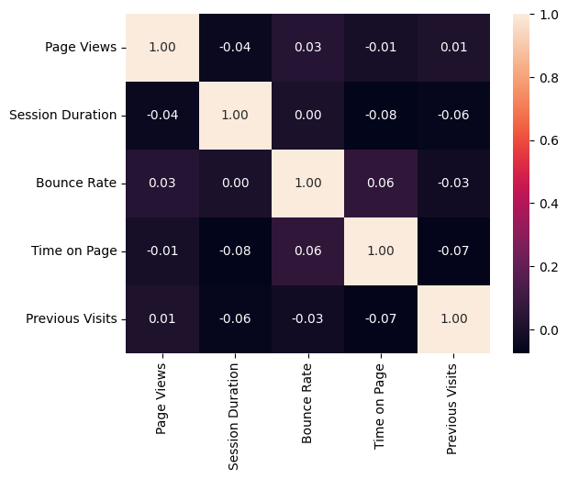
Screenshots Output

Slide 15
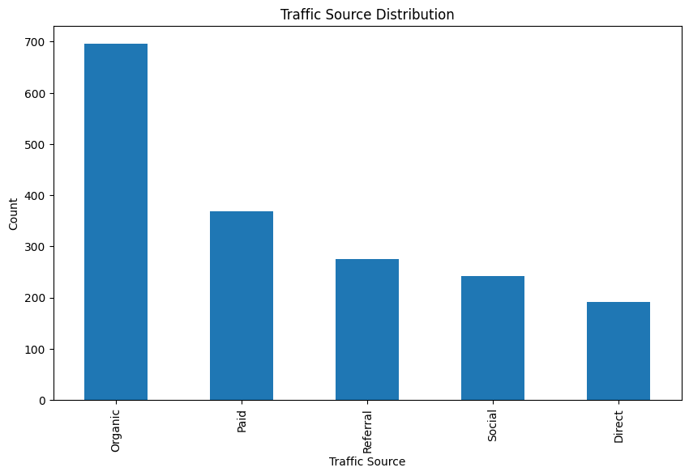
Screenshots Output

Slide 16
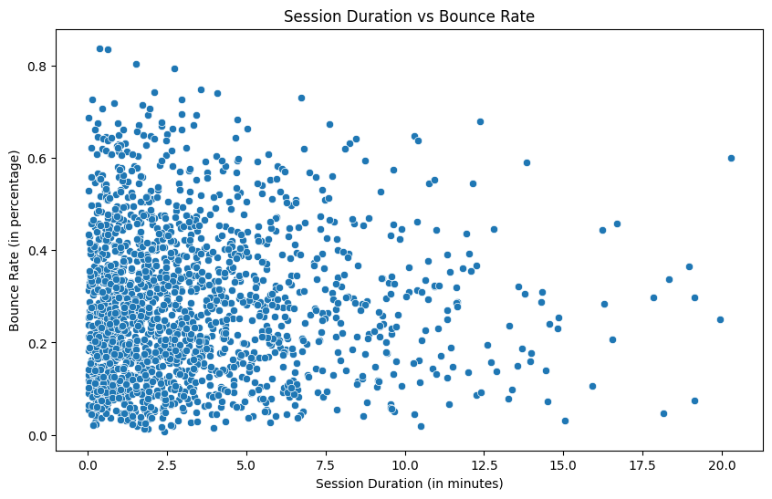
Screenshots Output

Slide 17
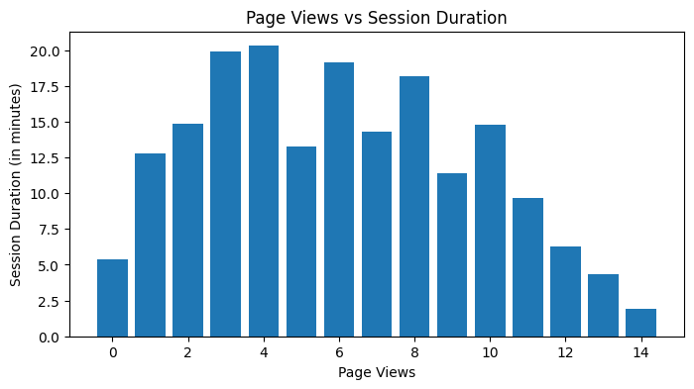
Screenshots Output

Slide 18
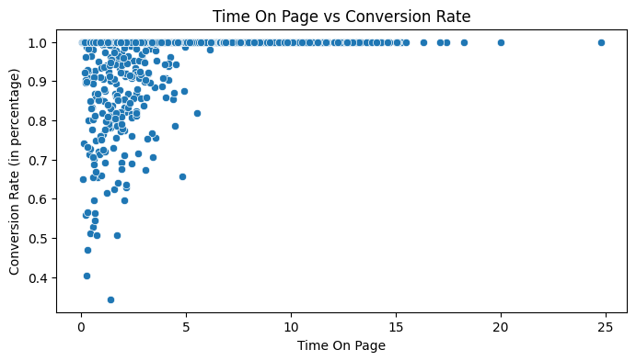
Screenshots Output

Slide 19
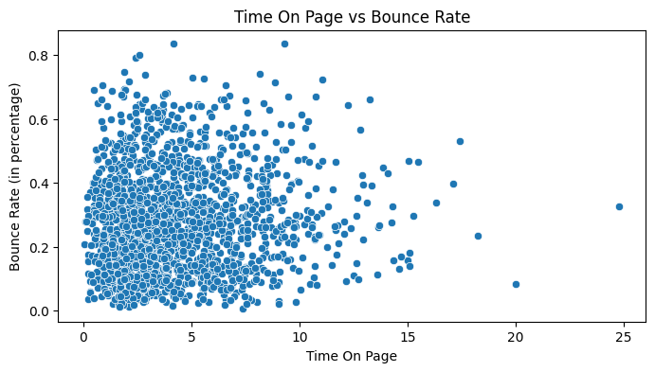
Screenshots Output

